Slide 1
Implementing Web Services in Java
View Java/J2EE and SOA course details at http://www.edureka.co/java-j2ee-soa-training
For Queries:
Post on Twitter @edurekaIN: #askEdureka
Post on Facebook /edurekaIN
For more details please contact us:
US : 1800 275 9730 (toll free)
INDIA : +91 88808 62004
Email Us : sales@edureka.co
www.edureka.co/java-j2ee-soa-training

Slide 2
Objectives
At the end of this webinar, you will be able to:
Understand SOAP
Implement WSDL
Work Of REST Services
Create a Restful App in JAVA

Slide 3
SOAP
SOAP is a protocol to access Web services.
SOAP stands for Simple Object Access Protocol. This protocol is based on XML.
SOAP was designed in 1998 by Dave Winer, Don Box, Bob Atkinson, and Mohsen Al-Ghose.
Service Requester
Service Provider
Handler 1
Handler 2
Handler
SOAP
message context
SOAP
message context
SOAP
message context
Client
Service
Request 1
Request 1
SOAP
Request 1
Response1
Response1
Response1

Slide 4
SOAP
SOAP stands for Simple Object Access Protocol
SOAP is used for communicating between two applications
SOAP is a format for sending messages
SOAP communicates via Internet using HTTP
SOAP is platform independent
SOAP is written using XML
SOAP is a W3C recommendation

Slide 5
SOAP - Example
For example: If we want to get the approval/declined status for credit card transaction from bank using SOAP, following steps to be done/will be executed:
In client module, write the details about the customer details like credit card, account number, expiry date, CVV2 etc., in SOAP format.
This SOAP message is sent on web to web service which provides the desired service.
The web service unpacks the SOAP message and converts into a command that the application can understand. Application will get the credit card information. It does the required processing and generates the response either approval/declined status in SOAP message.
This SOAP message is sent back to the client.
Client unpacks the SOAP message and gets the required information.

Slide 6
SOAP – Flow Diagram
unpacks the SOAP message and converts into a command that the application can understand
SOAP Message
Web Service
Client Module
Credit card
account number
expiry date
CVV2
……..
Web
Output in
SOAP Format

Slide 7
SOAP Files - WSDL, Client Generation
Server
Java Code - which does the actual operation/provides the service.
WSDL File - Web Service Description Language. This file says the information about the services like the functions and what input it takes and what output it generates etc.
Client
Using WSDL file, we can generate the client and can execute the web services.

Slide 8
Web Services - SOAP
Web Service is published in UDDI registry
UDDI stands for Universal Description, Discovery and Integration
Client looks in the registry for the services and gets connected with the required service and interacts with it
UDDI Registry
locate/get description UDDI
register/publish UDDI
Web Service Requestor
Web Service
Provider
invoke SOAP

Slide 9
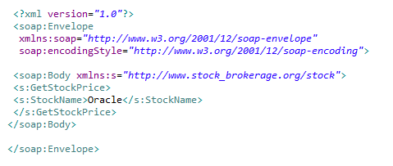
Example of SOAP Request

Slide 10
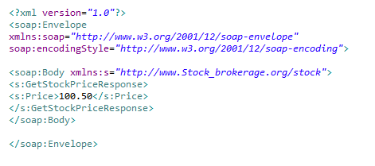
Example of SOAP Response

Slide 11
WSDL
WSDL is Web Services Description Language
WSDL is written in XML and it is a XML document
WSDL describes the Web services
WSDL is a W3C recommendation

Slide 12
WSDL
WSDL XML document has the following elements:
<types> - This section is used to specify the data types used by the web services.
<messages> - Messages for communication will be specified in this section. Input message and output message can be specified in this section.
<portType> - This defines the web service and the operations / methods to be executed. Also the messages that are involved in this operation /method. Messages could be input message and output message.
<binding> - This section defines the message bindings and transportation protocol.
<service> - Location of the service – URL.

Slide 13
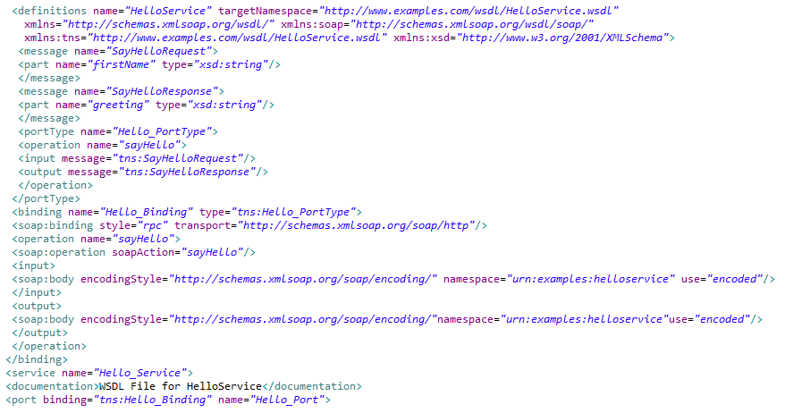
Example of WSDL File

Slide 14
REST Services
REST stands for Representational State Transfer
This service is developed using HTTP protocol
In Rest based architecture, similar to SOAP based Architecture, service is developed in REST and REST client has to be written to use the REST Service
Java defines REST support via the Java Specification Request (JSR) 311. This specification is called JAX-RS (The Java API for RESTful Web Services)

Slide 15
JAX-RS
Jersey is the reference implementation for JSR (Java Specification Request)-311
Jersey provides the library for RESTful Web Services using Servlet container
Download Jersey distribution from the site: https://jersey.java.net/download.html

Slide 16
Restful Services
REST is an architecture. RESTful service is a service which follows the REST architecture.
Following Annotations are used:
@Path (path) – Sets the path to the base URL. The base URL is the application name, servlet and URL specified in the web.xml.
@GET – Indicates the following method will address HTTP GET request.
@Produces – This function will generate the given output. It could be TEXT/HTML/XML formats etc.

Slide 17
Creating Restful Service
Create a dynamic web project in eclipse.
Add jersey jar files to the build path.
Add the web.xml under web content/WEB-INF directory.
Add a Java file and add the required code of the service.

Slide 18
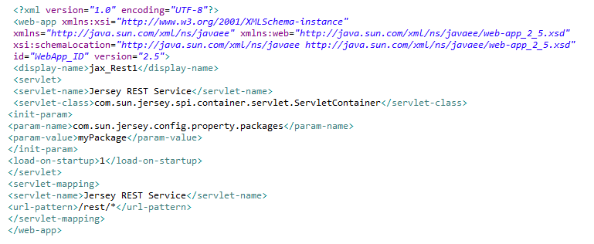
Restful Service – web.xml

Slide 19
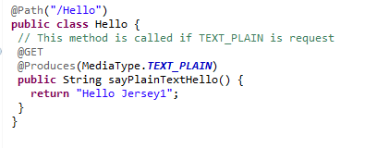
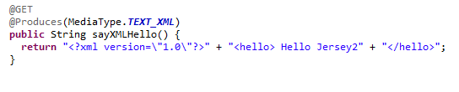
RESTful Service – Java Code

Slide 20
Creating Restful Service
Hello should be added for the path of this service.
Name of the class is Hello.
@GET – The following method will respond to GET method of the client request.
@Produces – This method returns the data specified in the Produces annotation.
Method returns the data.
Run the project so that Service is running on Apache Tomcat.

Slide 21
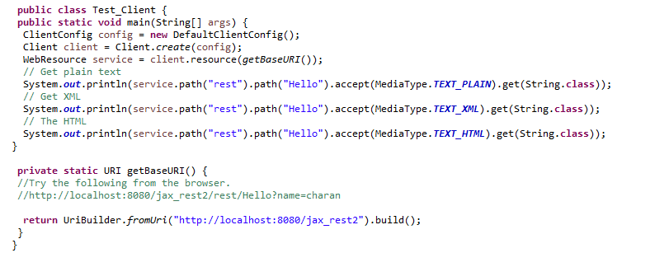
RESTful – Client

Slide 22
RESTful – Client
Base URL is obtained for the service.
Methods of RESTful services are invoked by using the path and the media type.
Apart from writing the client, service can be tested with the URL too
For example:
http://localhost:8080/jax_rest2/rest/Hello?name=edureka
Here, service is running under 8080 port.
Name of the application is jax_rest2, /rest/Hello is the Path and name=edureka
is passed as parameter to this service.

